Slide 1


GaKCo A Fast Gapped k-mer String Kernel using Counting
Ritambhara Singh, Arshdeep Sekhon, Kamran Kowsari, Jack Lanchantin, Beilun Wang, and Yanjun Qi
Notes:
Good afternoon, Today I Bryan, will present the work called GaKCo, on behalf of its authors at University of Virginia.

Slide 2
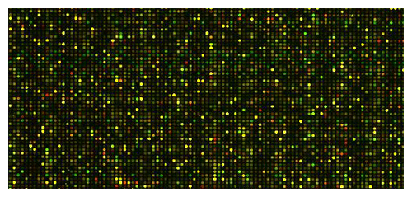


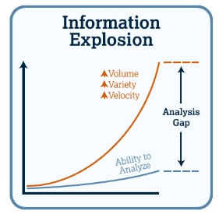




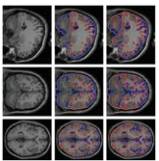
Challenge of data explosion
Molecular signatures of tumor / blood sample
Traditional Approaches
Signs &
Symptoms
Patient Medical History & Demographics
Public Health
Data
Data-Driven Approaches
Machine Learning
Genetic Data
Mobile medical sensor data
Medical Images
Notes:
Animation1: In recent years, development of technology has resulted in an explosion of information in volume, variety and velocity.
Animation 2: With large amounts of data pouring in from different types of domain, the traditional theory based approaches have given way to data-driven approaches, resulting in the popularity of
Animation 3: Machine Learning, where given some data, we try to train an algorithm to make predictions when new data point is observed.

Slide 3

String Classification: [Application I]
X
NO
(-1)
This Food is not good.
Notes:
An important application in this field is that of string classification, here given input string X
Animation 1: for example a sentence from a text-based review
Animation 2: The trained algorithm classifies it as a positive or a negative sentiment.

Slide 4

State-of-the-art Machine Learning Models
Deep Neural Network (DNN)
Support Vector Machine (SVM)
Notes:
There are two major state-of-the-art machine learning models for string classification: (1) Deep neural networks and (2) Support vector machines

Slide 5
State-of-the-art Machine Learning Models
Deep Neural Network (DNN)
Support Vector Machine (SVM)
Number of Training Samples
Notes:
While neural networks have shown great performance for different string classification tasks
Animation 1: They require large number of training samples to perform accurate classifications
Animation 2: However, sometimes we are confronted with complex data, “little data”, or rare events, where neural network based approaches suffer due to insufficient training samples.
Animation 3: In this scenario, methods like support vector machines provide accurate classifications with theoretical guarantees.

Slide 6
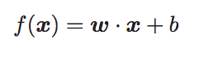
Support Vector Machine (SVM)
w . x + b ≤ -1
w . x + b = 0
w . x + b ≥ +1
Negative Instances (y = -1)
Positive Instances (y = +1)
Notes:
The basic idea of a support vector machine is that, given a set of positive and negative samples in our training data
Animation 1: We learn a function f
Animation 2: which is a decision boundary
Animation 3: separating the two types of samples
Animation 4: In such a way that the distance between the margins going through the edge points (or support vectors) are as large as possible.

Slide 7
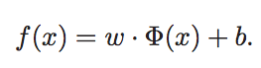
Kernel
X
𝛗(X)
X
K ( . )
Notes:
Sometimes, the input space X
Animation 1: is not easy to separate linearly, and thus SVMs are unable to perform classification
Animation 2: In this case, we use a kernel function that maps this input space into a higher dimensional feature space phi,
Animation 3: such that now the space becomes linearly separable
Animation4: and the SVM can learn a hyperplane dividing the positive and negative samples in space phi

Slide 8

String Kernels
Challenge : SK-SVM methods are slow
𝛗(X)
Feature Space
Support
Vector
Machine
S=ACACA
T=AAACA
ACACA
AAACA
Notes:
One example of such kernels is String kernel,
Animation 1: Since strings need to be represented numerically to input into a SVM, we use a string kernel to convert strings into numerical feature space
Animation 2: Next we use an SVM to perform classification in this feature space
Animation 3: Given two strings,
Animation 4: the string kernel captures the similarity among them
Animation 5: by comparing substrings of size k or k-mers
Animation 6+7: between the strings
Animation 8: Since we are comparing all possible substrings, the feature space explodes quickly making string kernel methods slow
Animation 9: Bringing us to the challenge that despite working with small number of training samples, string kernel based SVM methods can be slow

Slide 9
Solution: GaKCo
Faster than state-of-the-art string kernel
Independent of dictionary size
Parallelizable
Notes:
As a solution, the authors introduce Gakco:
A fast algorithm that is a novel combination of two efficient techniques: reduced feature space and counting based method to calculate kernel values
It scales up to large values of dictionary size
The proposed algorithm is naturally parallelizable and the authors present a multi-thread implementation which further improves the speed.

Slide 10
[Application II]: Does TF bind to this DNA sequence?
TF
?
?
DNA
Gene A
………ATCGACATAGC………
………CCCCTGACCATAGC………
ATCGAATCCG
CGCTGAATCG
ATCGCTATCG
ATCCCGCTCG
∑=4
Minimum Number
of Training Samples
1000
Notes:
Before I describe the details of the algorithm, and assuming we are familiar with text classification tasks like sentiment or document classification ,
I will briefly cover two important biological sequence classification tasks.
Task one is binding prediction of proteins called transcription factors that bind to sequence specific location on the DNA and affect gene expression. In this task, an important question for biologists is to figure out on a given DNA sequence,
Animation 1: whether a transcription factor binds to a specific location or not
Animation 2: This can be formulated as a classification task, such that given DNA sequence segments, we classify them as
Animation 3: positive or negative, that is whether TF binds or not
Animation 4: In this formulation, we have a dictionary size of 4 since DNA sequence is composed of 4 characters =A,T,C,G
Animation 5: The number of training samples can be as low as 1000

Slide 11
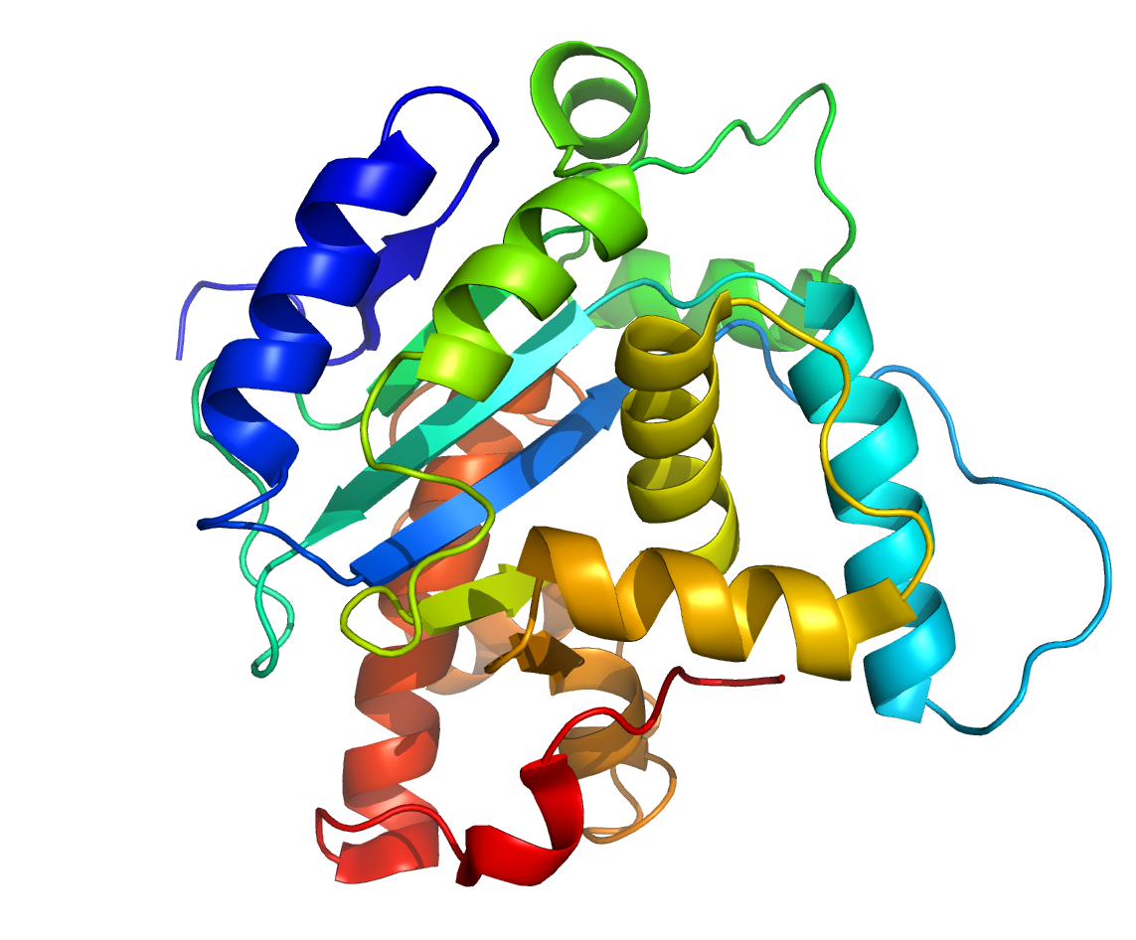
[Application III]: What family does a protein sequence belong to?
SCOP
Fold A
Super Family A
Fold B
Super Family B
Family A
Family B
Family C
Other Family
VQGGHACCAKKQQQ
∑=20
Minimum Number
of Training Samples
500
Notes:
The second important task is that of protein homology prediction. All the proteins can be divided into groups and sub groups such that proteins in the same family share similar properties.
Animation 1: Given a protein sequence
Animation 2: we would want to classify it as whether it belongs to a certain protein family or not. This will give us insight into the possible properties of that protein.
Animation 3: In this formulation, the dictionary size is 20 since protein sequence is composed of 20 characters
Animation 4: The number of training samples for this task can be as low as 500.

Slide 12
String Kernel + SVM Framework
Feature Space
𝛗(X)
Support
Vector
Machine
S=ACACA
T=AAACA
Notes:
All the described sequence classification tasks, fit perfectly into our string kernel with SVM framework.
I will now describe the string kernels in details

Slide 13
String Kernel
Mismatch Kernel
Spectrum Kernel
∑=2 {A,C}
Feature Space
AAA
AAC
ACA
CAA
CAC
CCC
k=3
S:ACACA
T:AAACA
m=1
Mismatch Neighborhood
{AAC, ACA, CAA..}
0
0
2
0
1
0
1
1
1
0
0
0
k-mers
ACA
CAC
ACA
k-mers
AAA
AAC
ACA
Bag of
k-mers
K(S,T) = <(0,0,2,0,1,0),(1,1,1,0,0,0)> =2
Notes:
Given two strings of dictionary size 2,
Animation 1: We define a substring length k=3
Animation 2 + 3: Next, using sliding window, we list all the possible k-mers in Sequence S
Animation 3 + 4: Similarly for T
Animation 5: Therefore what we have now is a "bag of k-mers" representation of the two strings
Animation 6: The feature space consists of all possible k-mers that can be obtained from the dictionary
Animation 7: We map the k-mers from the two strings to this feature space, obtaining numerical vectors
Animation 8+9: The kernel value is the inner product of these numerical vectors and thus captures the similarity among the two strings
Animation 10: This type of string kernel is called spectrum kernel
Animation 11: However, biological sequences are prone to insertions and deletions
Animation 12: Therefore, the notion of mismatch kernel was introduced
Animation 13: where we define mismatch neighborhood, which is all the k-mers that are at a distance m from the given k-mer, here m is the number of allowed mismatches, in this example that's 1.
Animation 14: so now, along with matching k-mers from S and T, we also match k-mers from mismatch neighborhood to calculate kernel values

Slide 14
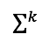
Computational Challenge
∑=20
Feature Space
k=10
(20)¹⁰ ~= 10¹³
AAA
AAC
ACA
CAA
CAC
CCC
1
1
0
0
0
0
Sparse!
Notes:
The issue with this method is that the feature space is exponential in size k
Animation 1: Therefore for large values of dictionary size and k
Animation 2: The feature space size explodes
Animation 3: Also the vectors obtained can be very sparse

Slide 15
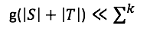
Related Work: Gapped k-mer Kernel (gkm-SVM)
∑=2 {A,C}
g=3
S:ACACA
T:AAACA
k=2
g-mers
ACA
CAC
ACA
k-mers
{AC,CA,…}
g-mers
AAA
AAC
ACA
k-mers
{AA,AA,…}
Feature Space
Gaps=g-k=1
Ghandi M, Lee D, Mohammad-Noori M, Beer MA. “Enhanced Regulatory Sequence Prediction Using Gapped k-mer Features”.
Notes:
To overcome this issue, a recent work introduced the a new type of kernel with state-of-the-art performance, called gapped k-mer kernel
Animation 1: Now, first we define a gapped instance of size g
Animation 2+3+4+5: Next, we list all the g-mers from strings S and T
Animation 6: Now we obtain k-mer from these g-mers allowing gaps of size g minus k, or 1 in this case
Animation 7: The key idea is that instead of exploring a feature space of all possible k-mers, we only explore k-mers that can be obtained from all possible g-mers in the dataset.
Therefore, the size of the feature space is reduced considerably

Slide 16
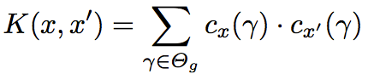
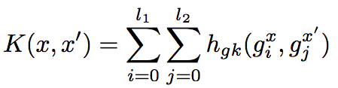
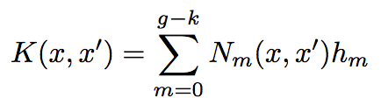
Related Work: Gapped k-mer Kernel (gkm-SVM)
(1)
(2)
(3)
Ghandi M, Lee D, Mohammad-Noori M, Beer MA. “Enhanced Regulatory Sequence Prediction Using Gapped k-mer Features”.
Notes:
The authors of the gapped k-mer kernel paper formulate this kernel for string x and x-prime as the following equation
Animation 1: the kernel value is calculated as inner product of the number of occurrences of k-mers gamma in feature space of g-mers theta g.
Animation 2: This can be re-written as composition of kernels computing inner product among g-mers from x and x-prime, of lengths l1 and l2 respectively. Here hgk represents the inner product (or similarity) between g-mers in x and x-prime using the co-occurrence of gapped k-mers as features.
Animation 3: The authors re-formulate it as the following equation, as a product of Nm, called mismatch profile and coefficient, hm. For explanation about this transition, please see details in the paper.

Slide 17
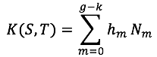
Related Work: Gapped k-mer Kernel
gkm-SVM
Trie
∑=2 {A,C}
Dependence on term (∑)^{m}
A
g=3
A
S:ACACA
T:AAACA
k=2
Time taken to compute Kernel for Protein dataset > 5 HOURS
g-mers
ACA
CAC
ACA
g-mers
AAA
AAC
ACA
C
Mismatch Profile
A
A
Coefficient
m=0
N_{m} = 2
Gaps=g-k=1
m=1
N_{m} = 3
Ghandi M, Lee D, Mohammad-Noori M, Beer MA. “Enhanced Regulatory Sequence Prediction Using Gapped k-mer Features”.
Notes:
For our example, we can write equation 3 as follows:
Animation 1: here hm is a coefficient that is pre-calculated
Animation 2: and Nm is the mismatch profile, that is number of common g-mers between S and T that are at a distance m, where m ranges from 0 to g-k
Animation 3: For example, for m=0 the mismatch profile is 2, ACA from S matches twice with ACA from T
Animation 4: Similarly for m=1, the mismatch profile is 3. Allowing one mismatch, ACA from S matches twice with AAA from T and CAC from S matches with AAC.
Animation 5: Now, the state-of-the-art kernel called gkm-SVM calculates this mismatch profile using the trie data structure
Animation 6: Thus, kernel calculation is dependent on dictionary size and exponential in gap size m. This can make the algorithm very slow. Animation 7: For example, for one of the protein sequence dataset, the algorithm takes more than 5 hours to calculate the kernel

Slide 18
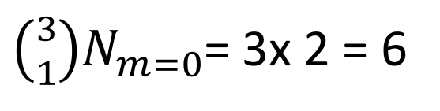
GaKCo : Gapped k-mer Kernel using Counting
S:ACACA
ACA
CAC
ACA
AAA
AAC
ACA
AA
AC
AC
CA
CA
CA
AA
AA
AA
AA
AC
CC
AA
AA
AC
AC
AC
CA
m=1
ACA
CAC
ACA
AAA
AAC
ACA
AAA
AAC
ACA
ACA
ACA
CAC
m=0
T:AAACA
N_{m} (S,T)=2
g=3
Independent of term (∑)^{m}
Parallelizable
Sort
Count
Sort
Count
C_{m} (S,T)=1+2=3
C_{m} (S,T)=4
C_{m} (S,T)=2
Total C_{m} (S,T)=3+4+2=9
N_{m=1} (S,T)= 9 – 6 =3
$\left({3 \atop 1}\right)N_{m=0}$= 3x 2 = 6
Over Counting =
Notes:
This brings us to the proposed solution GaKCo which calculates the mismatch profile using counting based method
Given two strings with g=3
Animation 1: for m=0,
Animation 2: we obtain all the g-mers,
Animation 3: sort them lexicographically,
Animation 4: and then count the matching g-mers to calculate the mismatch profile Nm. This is pretty straight forward for m=0
Animation 5: It becomes complicated for m=1
Animation 6: Now, we again list the g-mers,
Animation 7: but this time with position m=1 removed
Animation 8+9: We repeat sorting and counting as before
Animation 10: and now obtain, what we call, cumulative mismatch profile
Animation 11+12 + 13 +14: we do this again for the other two positions allowing m=1
Animation 15: This gives us the total cumulative mismatch profile. This cumulative mismatch profile is just the overcouting of the g-mers at distance m=1, that is we are not only including g-mers that are at distance 1 but also include the counts of g-mers that we already counted for m=0 Animation 16: These extra counts can be calculated as follows
Animation 17: and thus, subtracting this term from Cm gives us the exact mismatch profile for m=1
Animation 18: The algorithm is independent of the dictionary size and its exponential term m. Also, the calculation of Cm is independent for different values of m ranging from 0 to g-k. Therefore this algorithm is naturally parallelizable

Slide 19
GakCo is Faster!
Notes:
Here, the authors present the performance comparison of GaKCo with baseline gkm-SVM. Figure a shows the kernel calculation time for Gakco on x-axis and gkm-svm on y axis. We can see, that For 19 tasks ranging from DNA sequence, Protein sequence and Character-based text classification, GaKCo outperforms gkm-SVM for 16 tasks in speed for best chosen hyperparamters g and k.
Figure b shows the empirical performance of both algorithms. Thus, Gakco provides better kernel calculation speed than state-of-the-art string kernel with the same empirical performance.
[Extra note (if anyone asks): the micro-F1 score is plotted for 1 text classification task on webKB dataset where there were 4 classes, for rest there were only 2 classes, hence the AUC score has been plotted)]

Slide 20
Scales well with increasing ∑ and m
gkm-SVM : > 5 hrs
GaKCo : 4 mins
Notes:
Next, the authors show the effect of increasing dictionary and gap size on the speed of kernel calculation.
Kernel calculation times are plotted for best g and varying k such that gapsize M = (g − k) ranges from 1 to g − 1 for
DNA (b) protein and (c) Sentiment datasets.
The best performing hyperparameters are highlighted as red colored dashed lines.
For GaKCo, results are shown for both single thread and multi-thread implementations. GaKCo with single thread outperforms gkm-SVM for a large dictionary size and a large number of gap size that is M greater than 4.
The final GaKCo multi-thread implementation further improves the performance.
Animation 1: For protein dataset in figure (b) gkm-SVM takes > 5 hours to calculate the kernel, while GaKCo calculates it in 4 minutes.

Slide 21
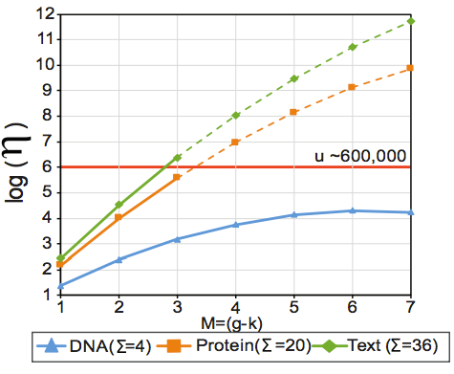
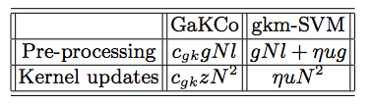
Detailed Theoretical Analysis (in paper)
Notes:
The authors have provided detailed theoretical analysis in the paper, where they explain and compare the asymptotic time complexities of both GaKCo and baseline gkm-SVM algorithms.
To their knowledge, this analysis has not been reported before. Details of this analysis has been provided in the paper.

Slide 22
Summary: GaKCo
Fast – (1) reduced gapped k-mer feature space and (2) counting based method
Scalable – allows larger dictionary size and gap size
Parallelizable – naturally parallelizable implementation
Code and datasets available at: https://github.com/QData/GaKCo-SVM
ArXiv: https://arxiv.org/abs/1704.07468
Notes:
In summary, the proposed approach Gakco:
is fast algorithm that is a novel combination of two efficient techniques: reduced gapped k-mer feature space and counting based method to calculate kernels
It gives same accuracy as state-of-the-art string kernel method but with a significant speedup in kernel calculation,
It scales up to large values of dictionary size and gap size
Since the proposed algorithm is naturally parallelizable, the authors present a multi-thread implementation which further improves the speed.
The authors have shared their code and datasets on github.
The arxiv version of the paper consists of supplementary with extra details about the datasets, comparison with neural networks, discussion on choice of algorithm that is sorting versus hashing and more experiments.

Slide 23

Thank you
Notes:
For questions please feel free to reach out to the authors. Thank you!

